Slide 2


Slide 4
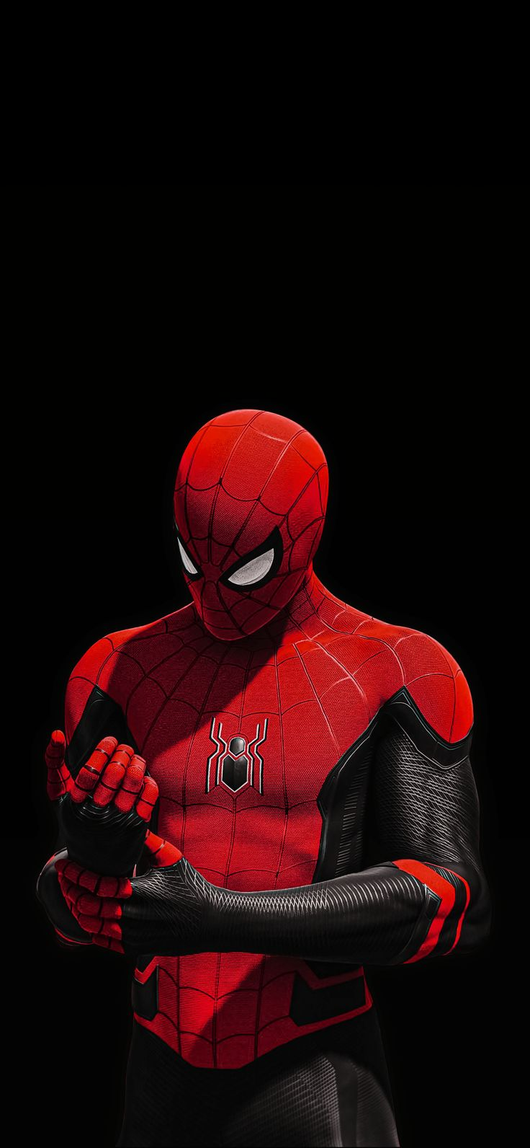
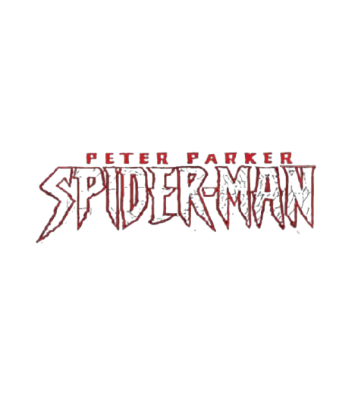
Spider-Man is a Marvel Comics superhero created by Stan Lee and Steve Ditko in August 1962. After being bitten by a radioactive spider, teenager Peter Parker gained superhuman abilities. Guided by his motto, "with great power comes great responsibility," he uses his powers to fight crime in New York City.

Slide 5
